Slide 1

The emergence of APM in cloud application development
Vipin Menon
Developer, Instana AIOPs, IBM
vipinmv1@in.ibm.com
https://github.com/vipinmenon
@vipinaiswarya
www.jcon.one
# JCON2021
October 5-8, 2021

Slide 2
Contents
What is APM ?
Monoliths
Characteristics of modern workloads
Where chaos begin ?
Modern APM is not just APM?
What industry needs?
References
Q&A
Demo
Microservices
Microservices: Dynamic Graph Architecture

Slide 3
What is APM ?
End User Experience
Runtime Application Architecture
Business Transactions
Deep Dive component monitoring
Analytics
Application Performance Monitoring or Management.
The translation of IT metrics into business value
Gartner Model
Source: wiki

Slide 4




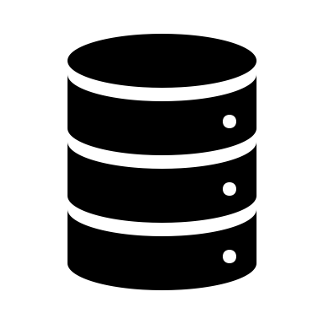
Monoliths
UI
Business Logic
Data driver
Database
APM
Monolith Architecture

Slide 5
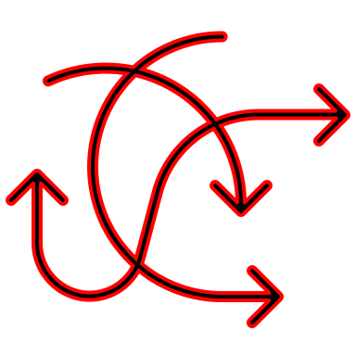
Microservices
APM
Microservices Architecture

Slide 6

Characteristics of Modern workload
Virtual and Distributed environment
Dynamic data models
Loosely coupled
Multi data sources
Multi dimensional delivery pipelines
Easily scalable and unscalable

Slide 7

Where chaos begin ?
Monitoring full stack turns nearly impossible
Continuous deployments need frequent reconfiguring
Data is not granular due to high dynamism
Lack of context due to technology abstraction
Expertise on new technologies for troubleshooting
Inefficient organisation of monitoring data
timely alerts can be delayed

Slide 8

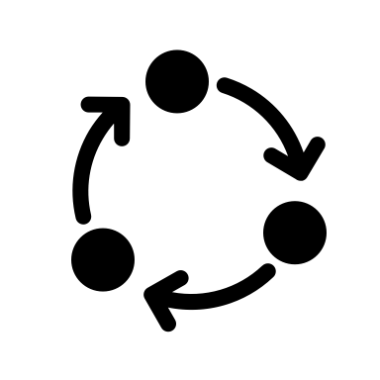


What industry needs ?
User Experience
Collective monitoring
Collective analysis
Error Prediction
support polyglot
Application Performance
Manage distribution in production
Collective Analysis
Error Prediction
User Experience
User experience
Application Performance
User experience
Collective monitoring
Seamless Integration
Error Prediction
Polyglot support
Developer
Operations
Sales
Customers

Slide 9
Modern APM is not just APM
Flawless
More of AI
Less Interactions
Scalable
Traceable
User Experience
Polyglot
Microservices are growing

Slide 10
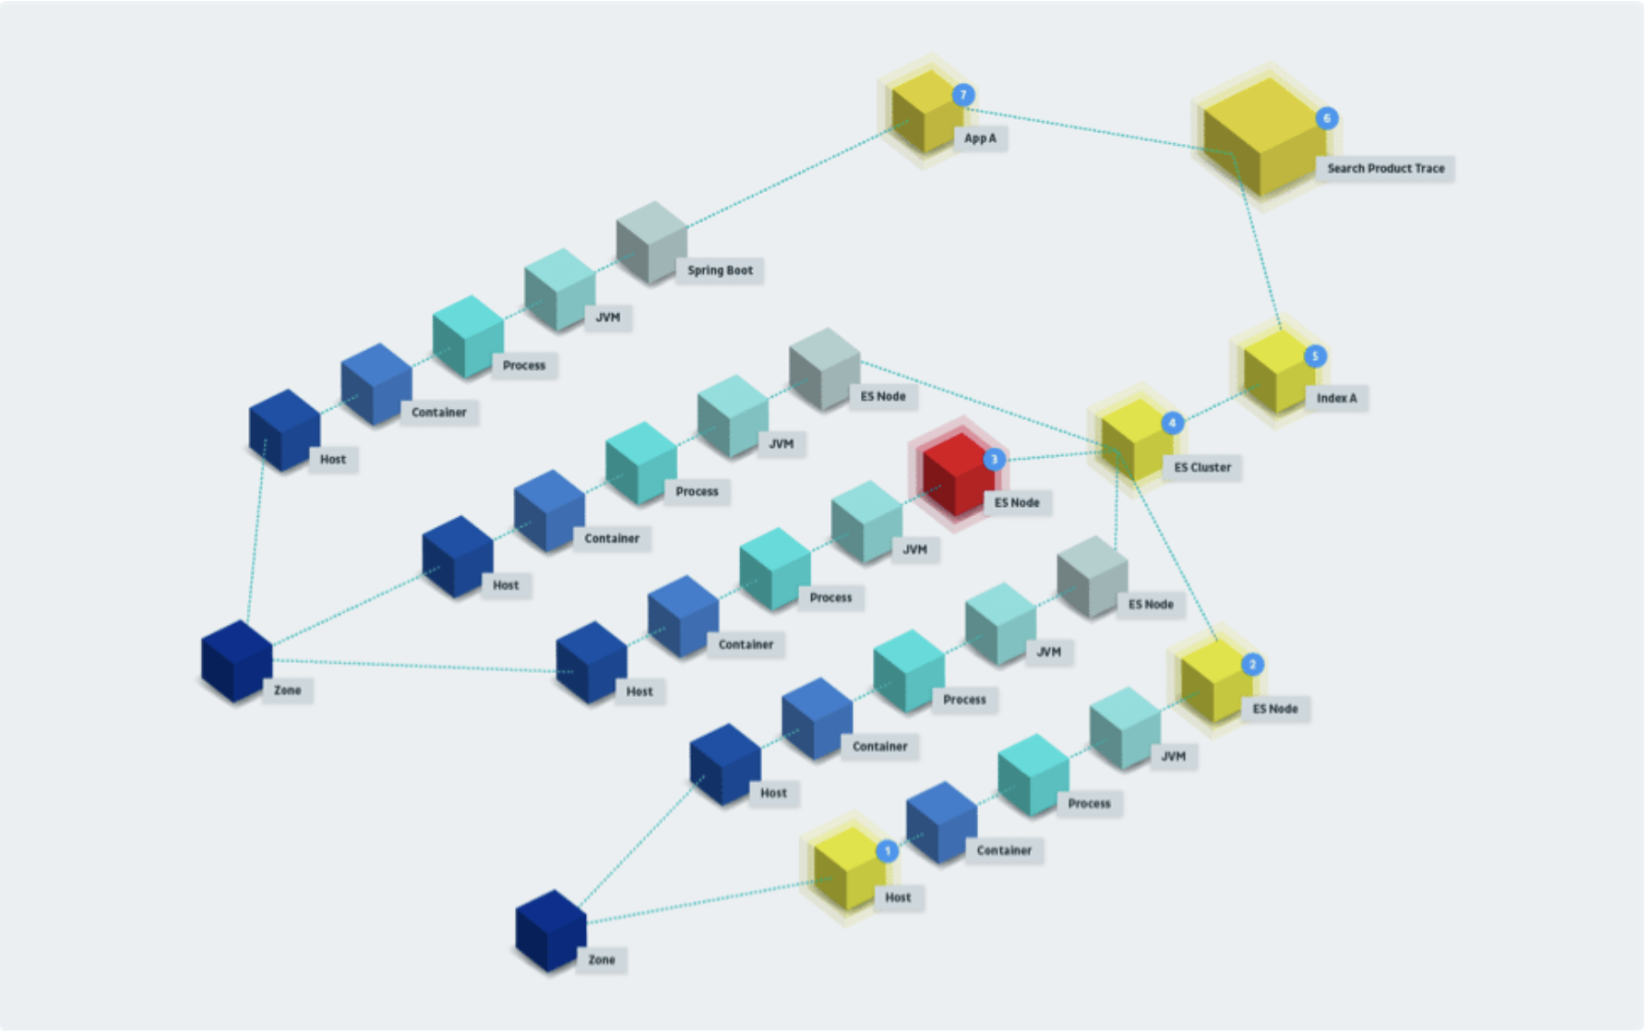
Microservices: Dynamic Graph Architecture

Slide 11

Demo

Slide 12

Q & A

Slide 13

References
https://docs.broadcom.com/doc/the-definitive-guide-to-application-performance-monitoring
https://smartbear.com/learn/performance-monitoring/what-is-application-performance-management/
https://www.ibm.com/cloud/architecture/architectures/cloud-native/
https://www.instana.com/blog/9-new-issues-impacting-cloud-container-based-applications/
https://www.appdynamics.com/c/dam/r/appdynamics/Gated-Assets/ebooks/ebook-the-need-for-next-generation-application-performance-monitoring.pdf
https://www.instana.com/blog/monitoring-microservice-applications-introducing-dynamic-graph/
https://www.instana.com/blog/application-performance-management-3-0-time-new-approach-apm/

